Slide 1
2023 Honor Awards
A Celebration of Better Illinois Communities by Design

Slide 2
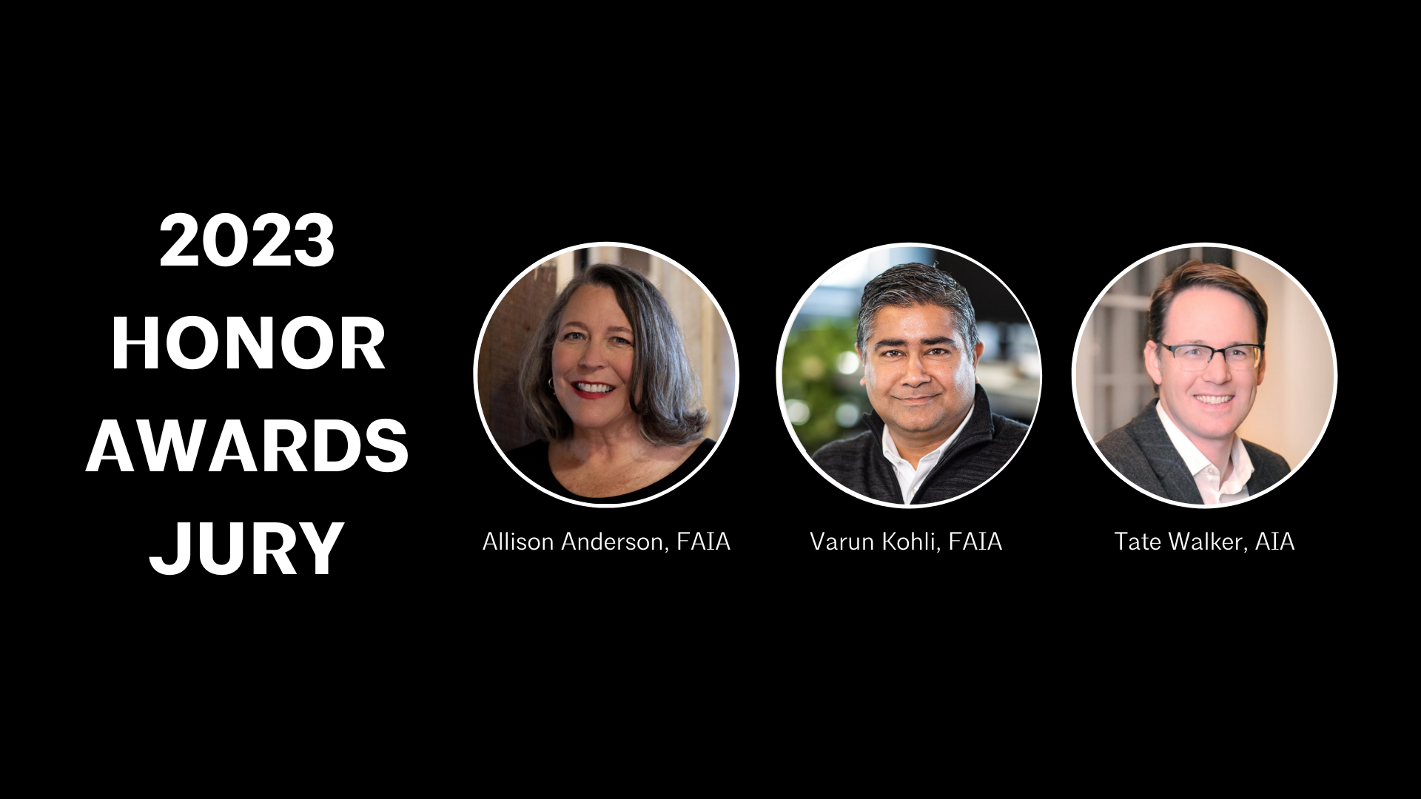

Slide 3
2023 Design Awards

Slide 4
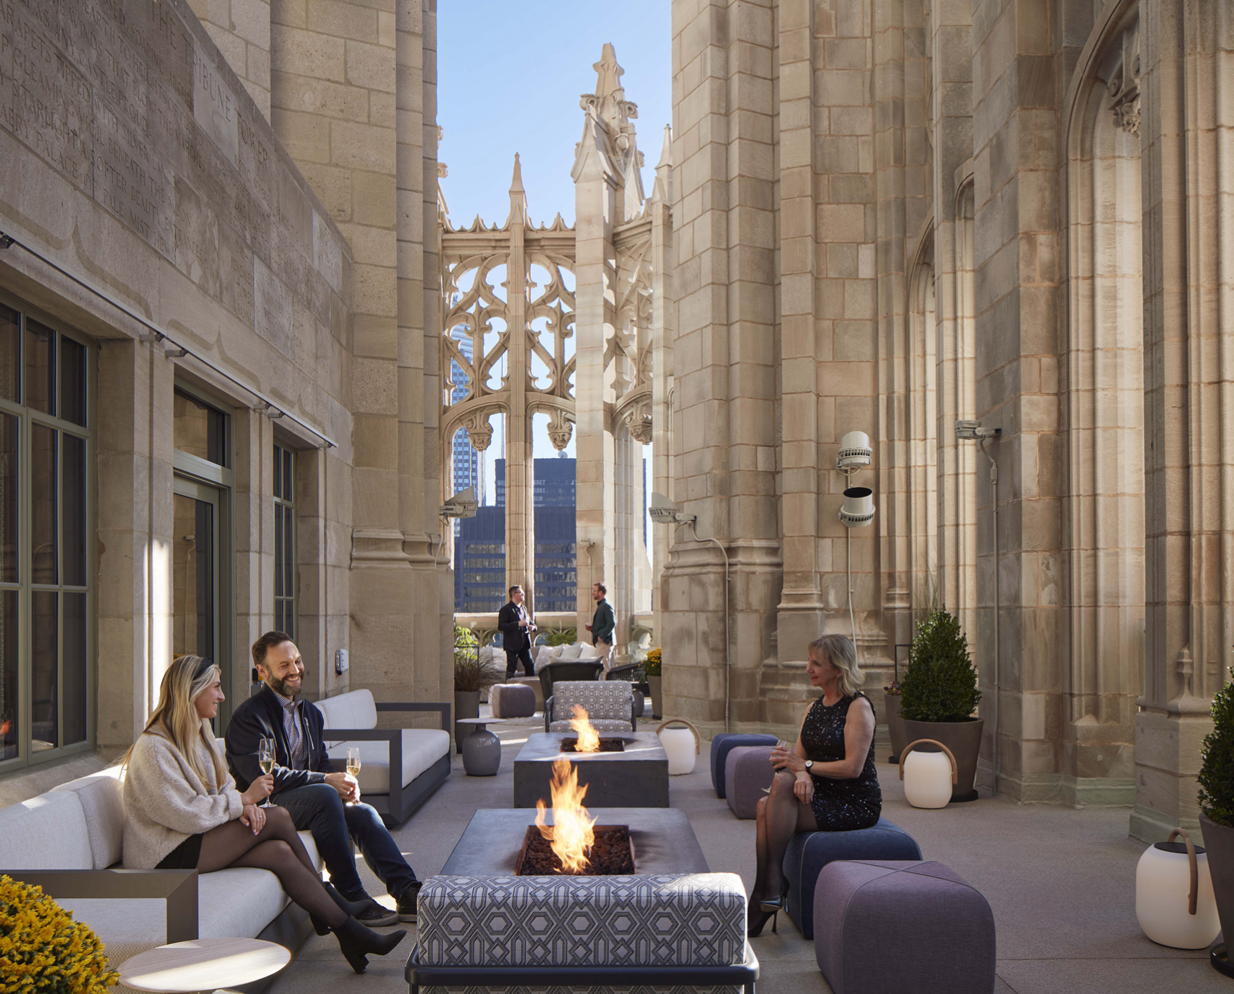
Tribune Tower Conversion
For Excellence in Historic Preservation - Project construction value $5 million and above
"A meaningful change of use and deconstruction of the Tribune Building," one juror said. "Hope to see more of this brand of urban renewal in the future."

Slide 5
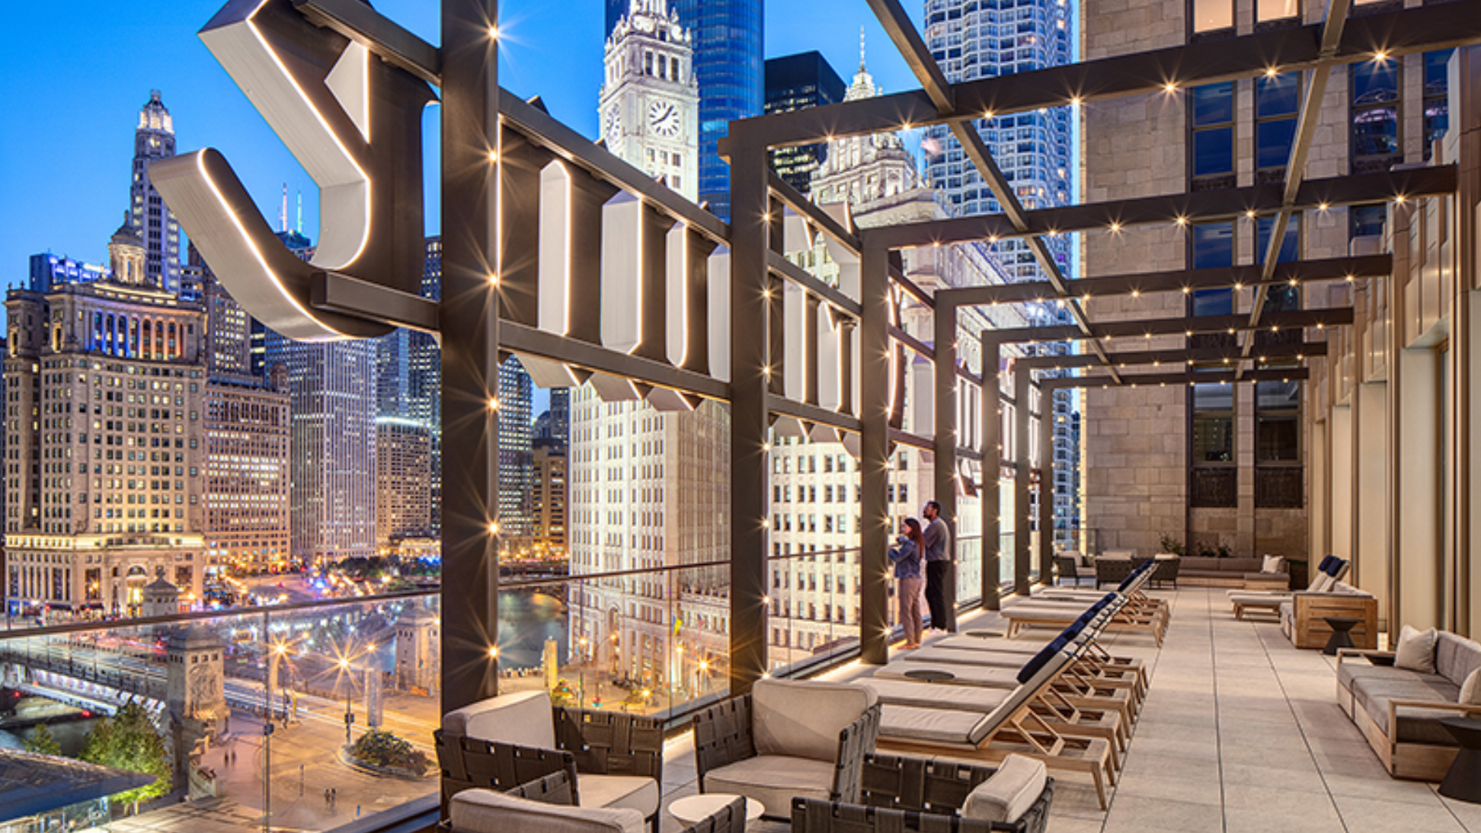

Slide 6
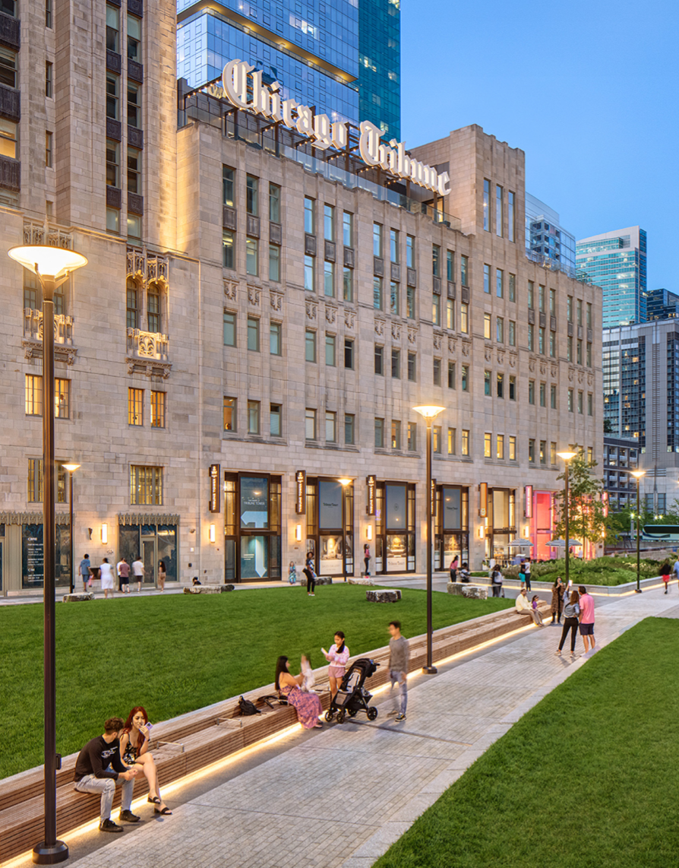
Project team includes:
Architect of Record: Solomon Cordwell Buenz (SCB),
Steven Hubbard, AIA
-Architect: Vinci/Hamp Architects, Inc., Philip Hamp, FAIA
-David Paoli
-Shriner Acoustics
-Laura Shafer
-Ray Volk
-Ryan Schommer
-Landscape Architect: Bradley McCauley
-Owner: Lee Golub
-Owner: CIM
-Structural Engineer: Roger Reckers
-Mechanical Engineer: Matthew Swanson
-General Contractor: Brian Lucas

Slide 7
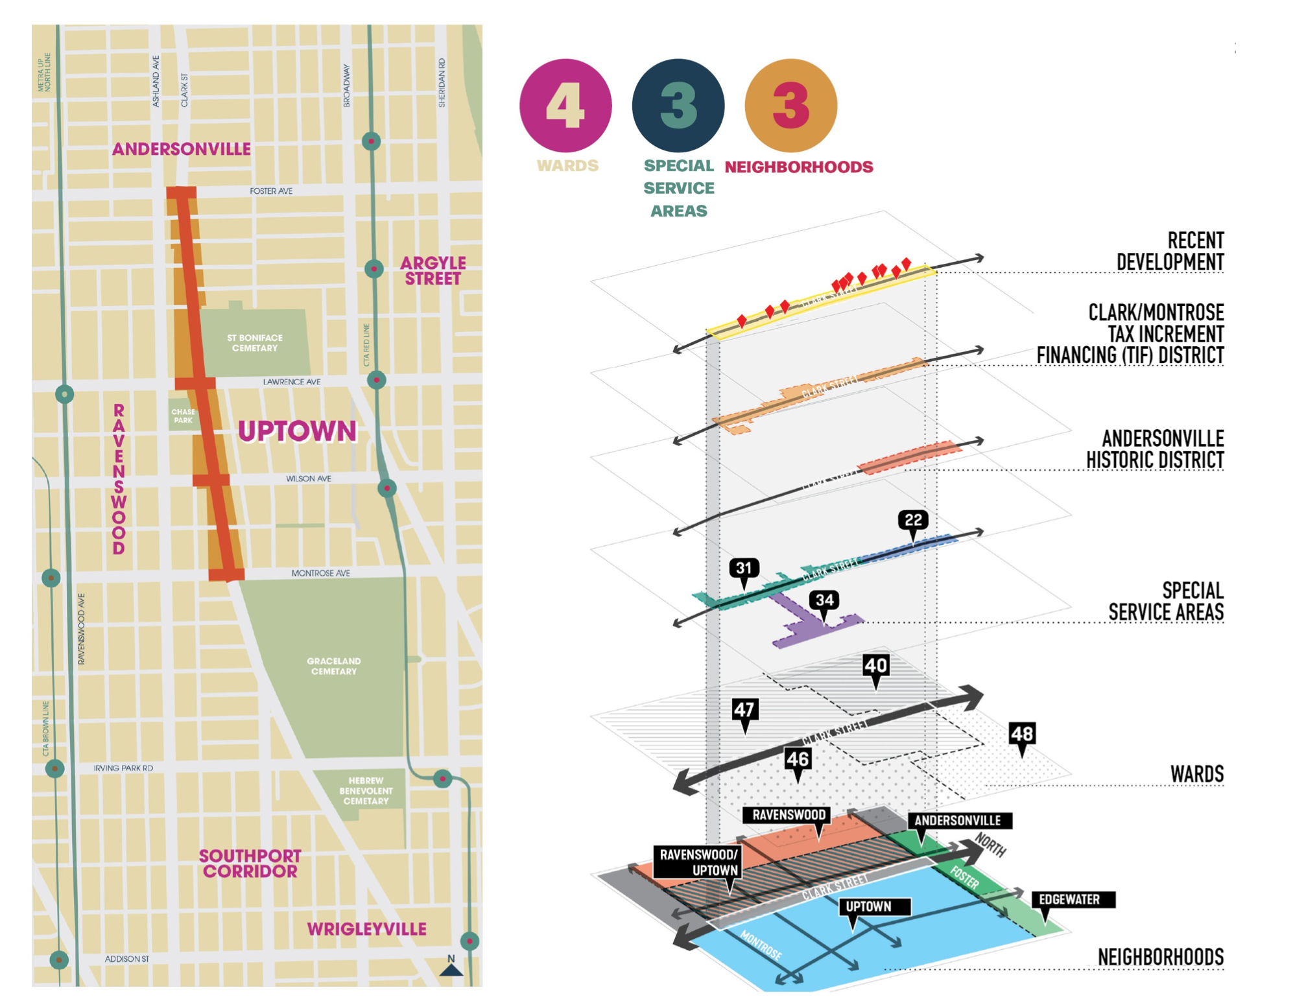
Clark Street Crossroads Corridor Study
For Excellence in
Master Planning
"There is meaningful planning here that brings together key urban design features into the existing urban context," a juror said.

Slide 8
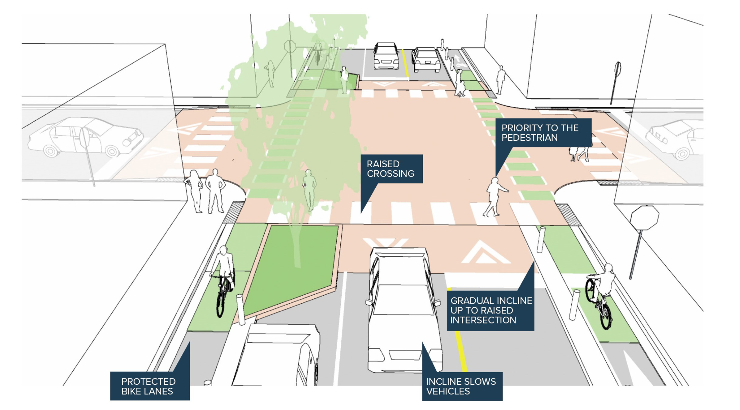

Slide 9
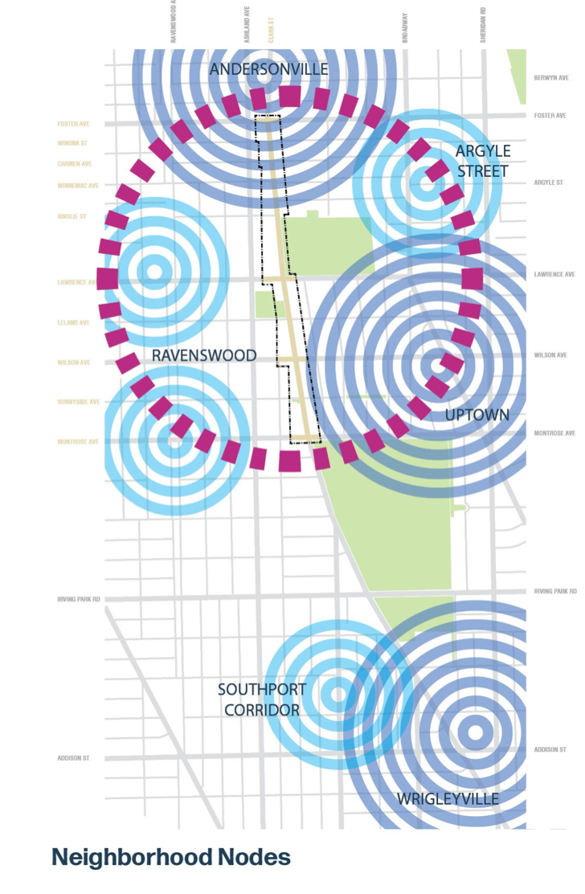
Project team includes:
Architect of Record: SmithGroup
-Principal in Charge/Architecture: Matt Dumich, FAIA
-Architecture/Planning: Janet Attarian, AIA
-Planning: Caeley Hynes
-Landscape Architecture: Matt Callone
-Architecture: Cristina Gallo, Via Chicago Architects X Disenadores
-Landscape Architecture: Brett Weidl, MKSK
-Economic Development/Market Research: Lance Dorn, SB Friedman Development Advisors
-Marketing/Branding/Engagement: Abigail Rose, All Together
-Client/City Planner: Katharyn Hurd, City of Chicago Department of Planning and Development

Slide 10
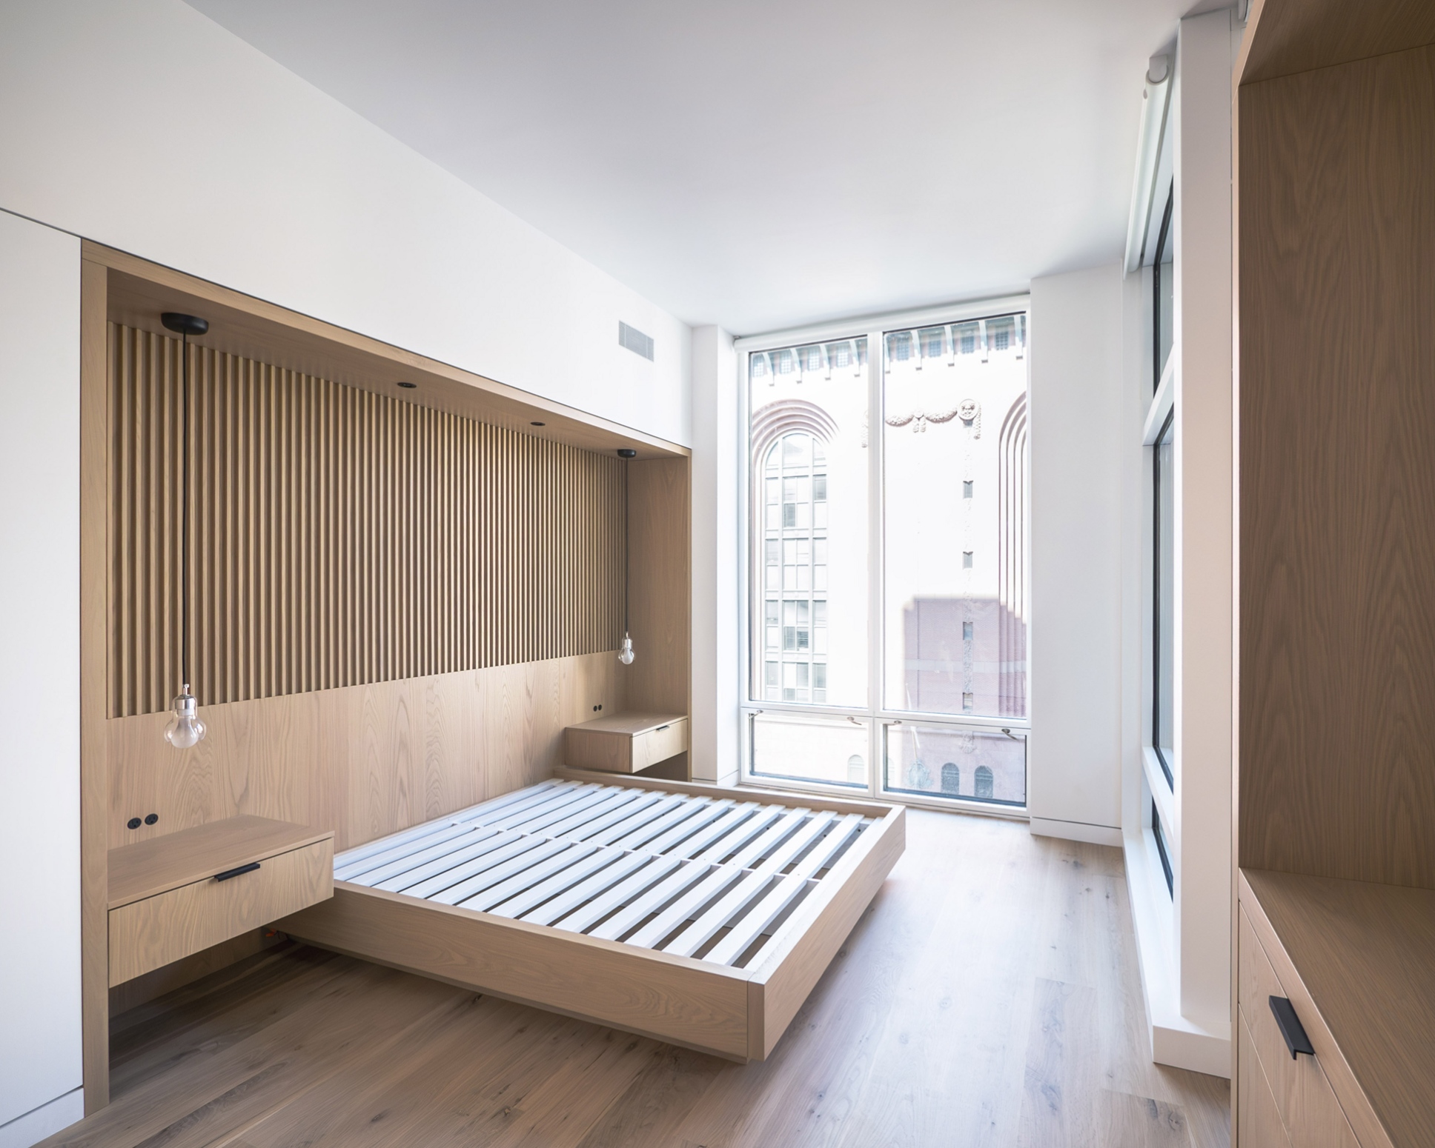
State Street Apartment
For Excellence in Interiors – Projects Below 5,000 SF
"This is a well-designed and smart project, especially as it pertains to occupant use and flexibility as well materiality," a juror said. "Amazingly crafted small project!" said another juror.

Slide 11
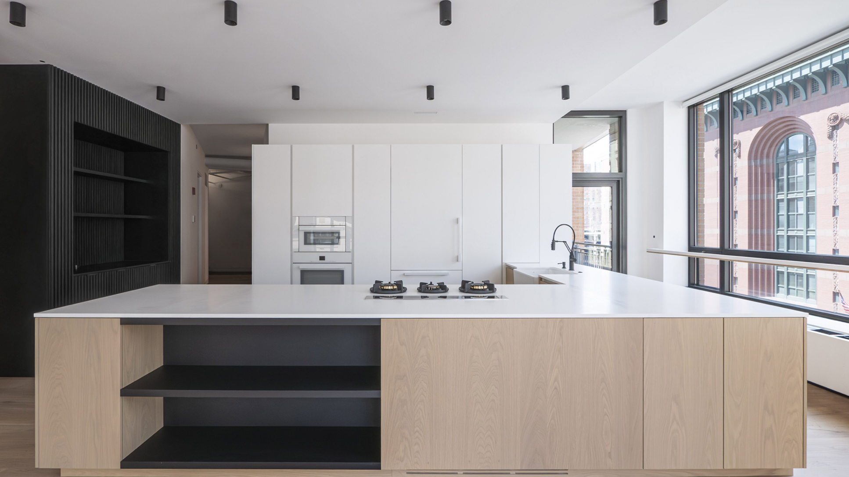

Slide 12
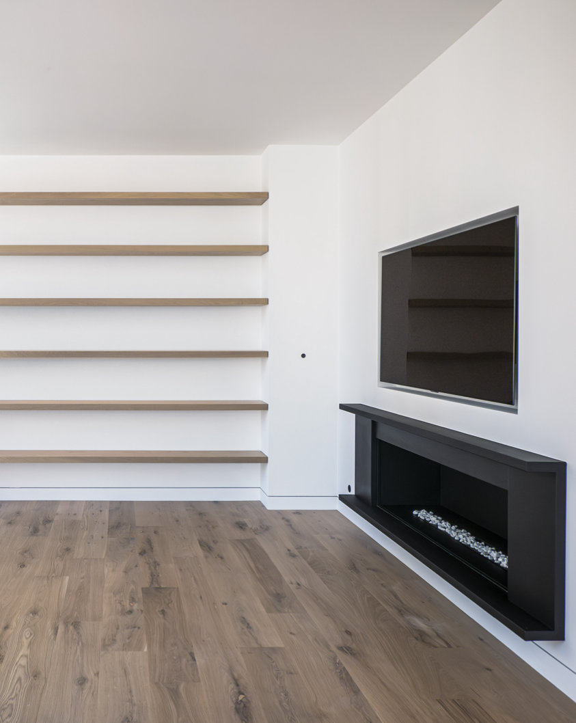
Project team includes:
Architect of Record: Eric Rothfeder, AIA
-Landscape Architects: Mimi McKay, McKay Landscape Architects
-General Contractor: Pat Straky
-Mechanical Engineer: Brian Rayski

Slide 13

Midtown Faust
For Excellence in Historic Preservation – Project Construction Value Below $5 Million
"The story of Midtown Faust is just amazing," said a juror. "Restoration of a historic building that regenerates its urban realm is remarkable."

Slide 14
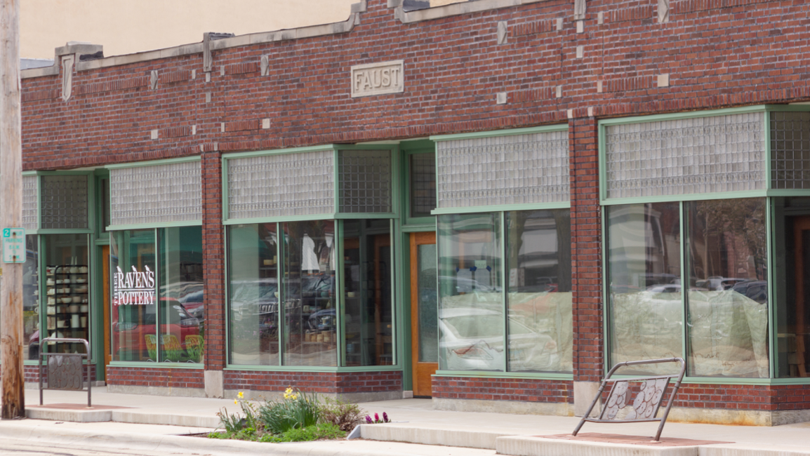

Slide 15
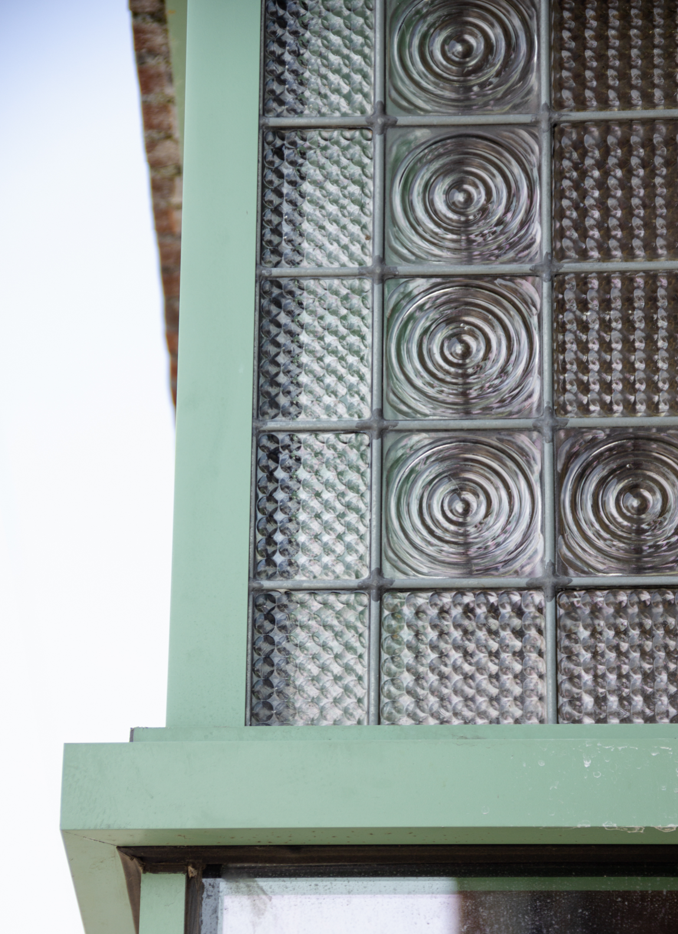
Project team includes:
Architect of Record: Studio GWA
-Aaron Holverson, AIA
-Gary Anderson, AIA
-Ashley Sarver, AICP
-Owner: Brad Roos, Roos Construction and Development
-Owner: Sue Roos, Roos Construction and Development

Slide 16
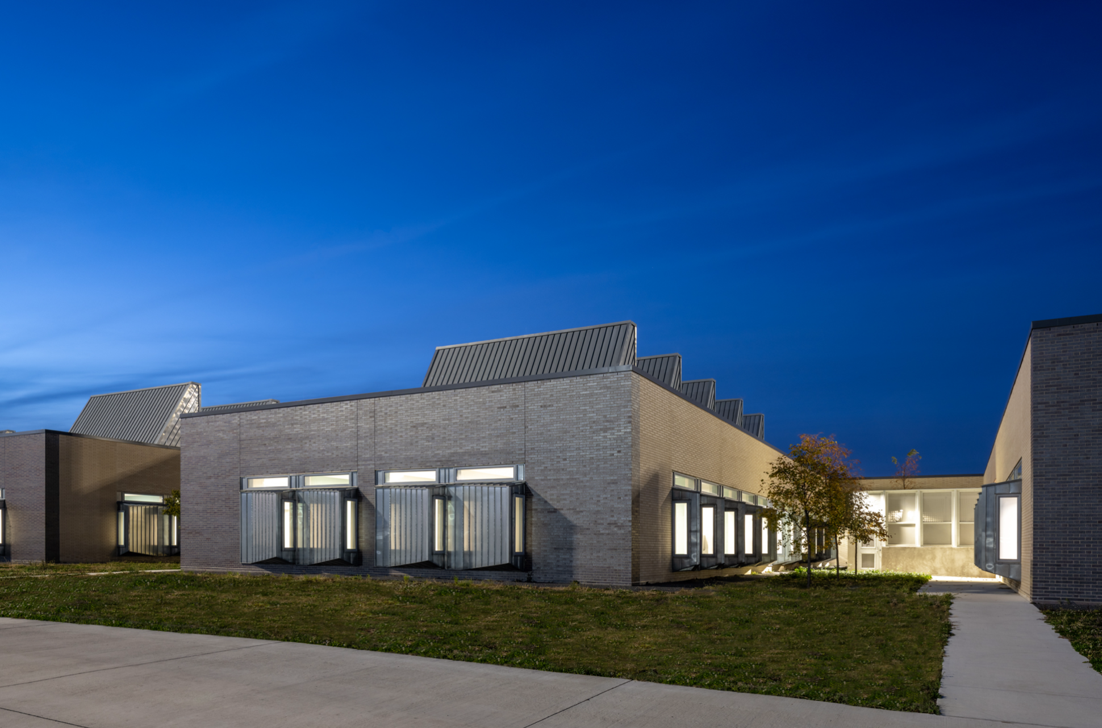
Joliet Inpatient Treatment Center
Greatest Impact – Project Construction Value $5 Million and Above
"It's worthy of an award because of its approach to occupant health and wellness - demonstrating the contributions of good architecture in a broken system," said a juror. "The daylighting is heroic - easily visible and provides a unique character for a building typology that is typically characterized by its cold hard shell and razor wire."

Slide 17
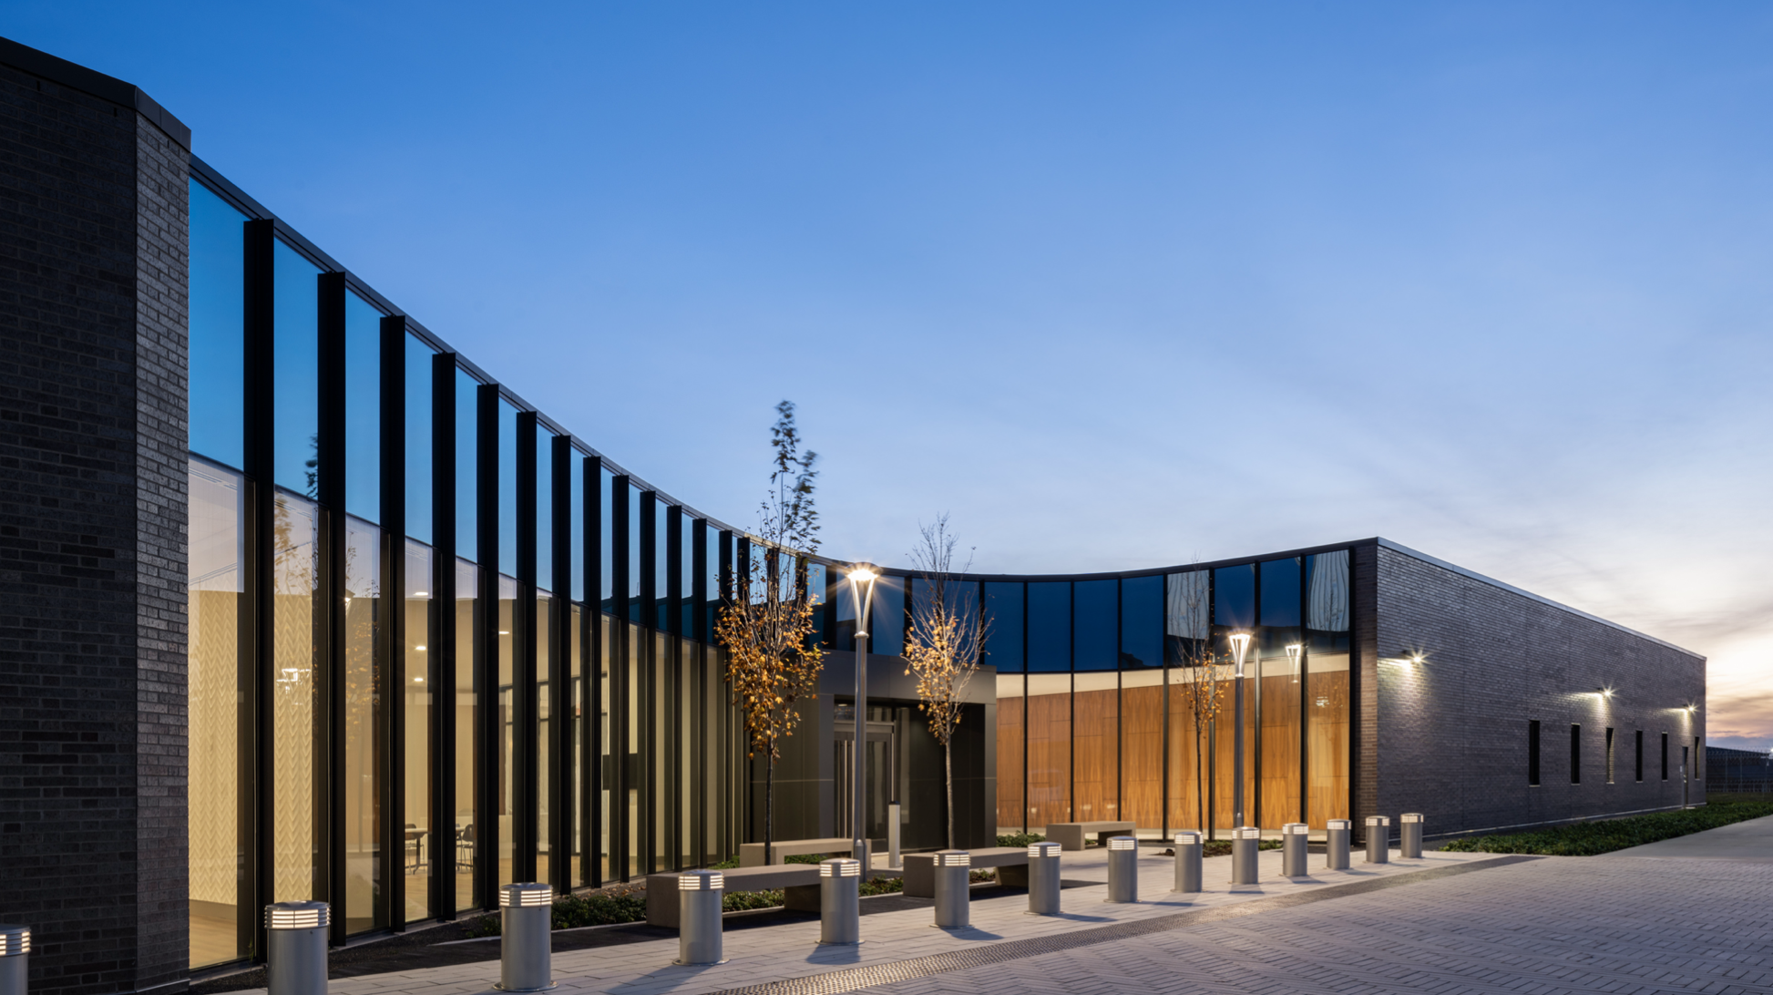

Slide 18
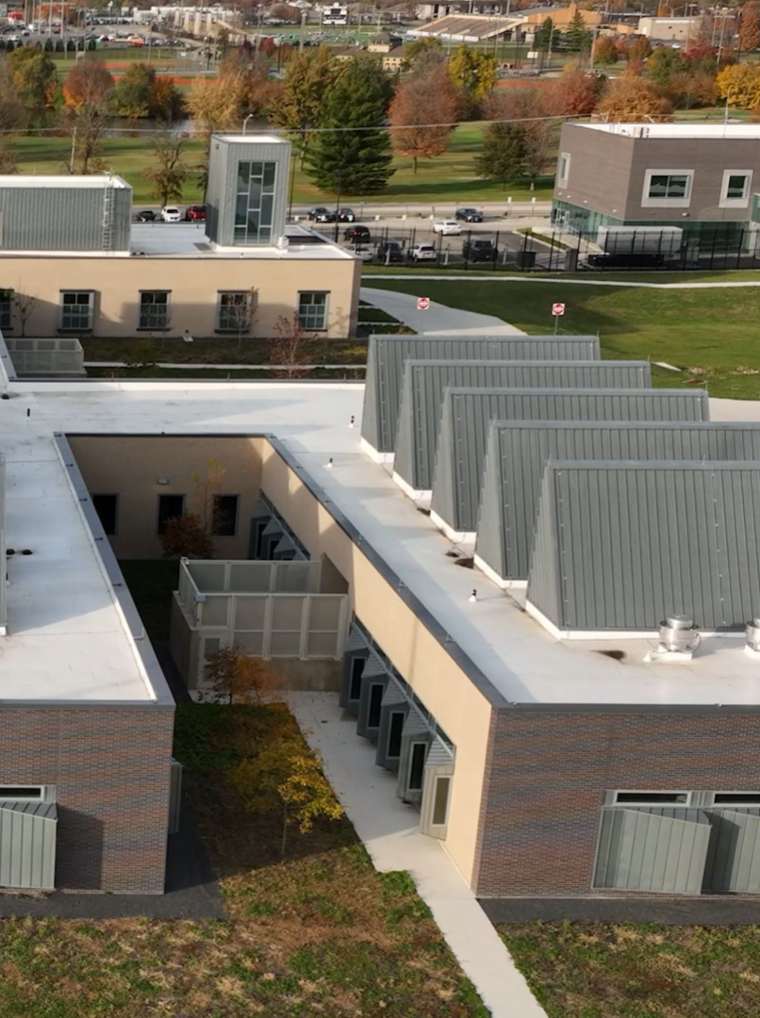
Project team includes:
Architect of Record: HDR, Terry Littell, AIA
Design Architect: HOK
-Melvin Cohen
-Ajay Shah
-Randy Tritz
-James Camancho
-Jason Dwyer
-David Bogard
-Owner: Steve Halm, State of Illinois
-General Contractor: Phil Kingdon
-Mechanical Engineer: Bruce Coleman
-Structural Engineer: Farhad Rezei

Slide 19
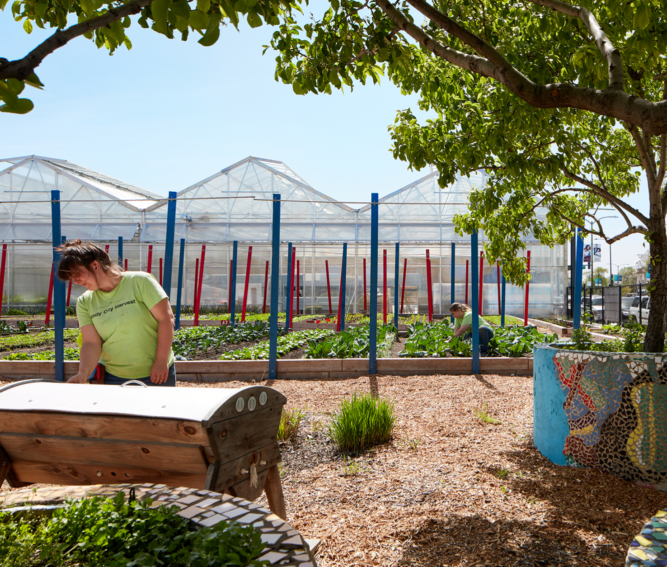
Farm On Ogden
Greatest Impact - Project Construction Value Below $5 Million
"Cities are typically places where food is consumed, not grown. This project plays an important role in introducing city dwellers to the art of agriculture," one juror said. "This project's mission hits every part of the framework for design excellence. Innovative use of wastewater in the process of growing food and raising fish."

Slide 20
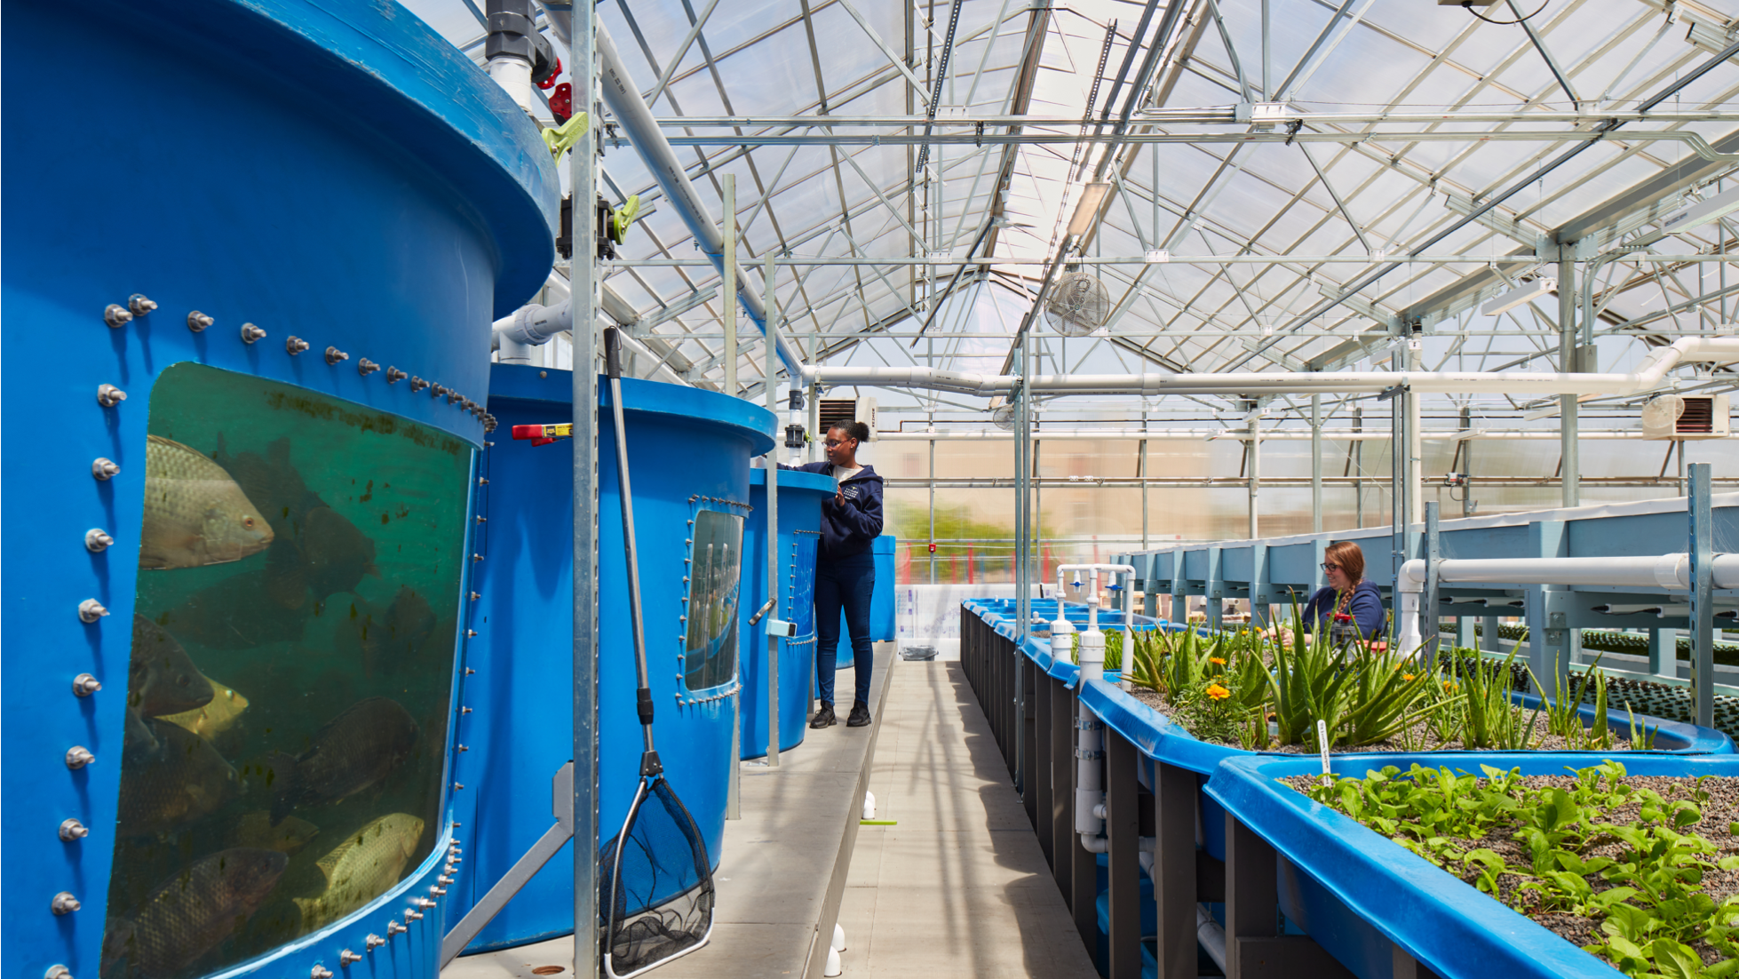

Slide 21
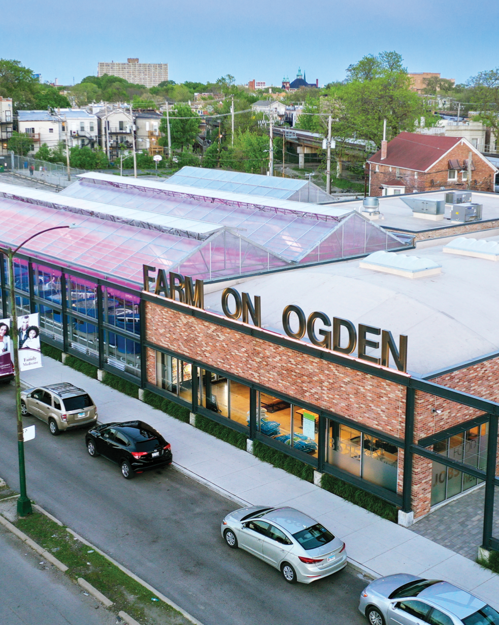
Project team includes:
Architect of Record: Booth Hansen
-Landscape Architect: Confluence
-General Contractor: Cazim Construction Corporation
-Structural Engineer: Forefront Structural Engineers
-MEP Engineer: Ramm Associates
-Civil Engineer: Eriksson Engineering Associates
-Client: Chicago Botanic Garden + Lawndale Christian Health Center

Slide 22
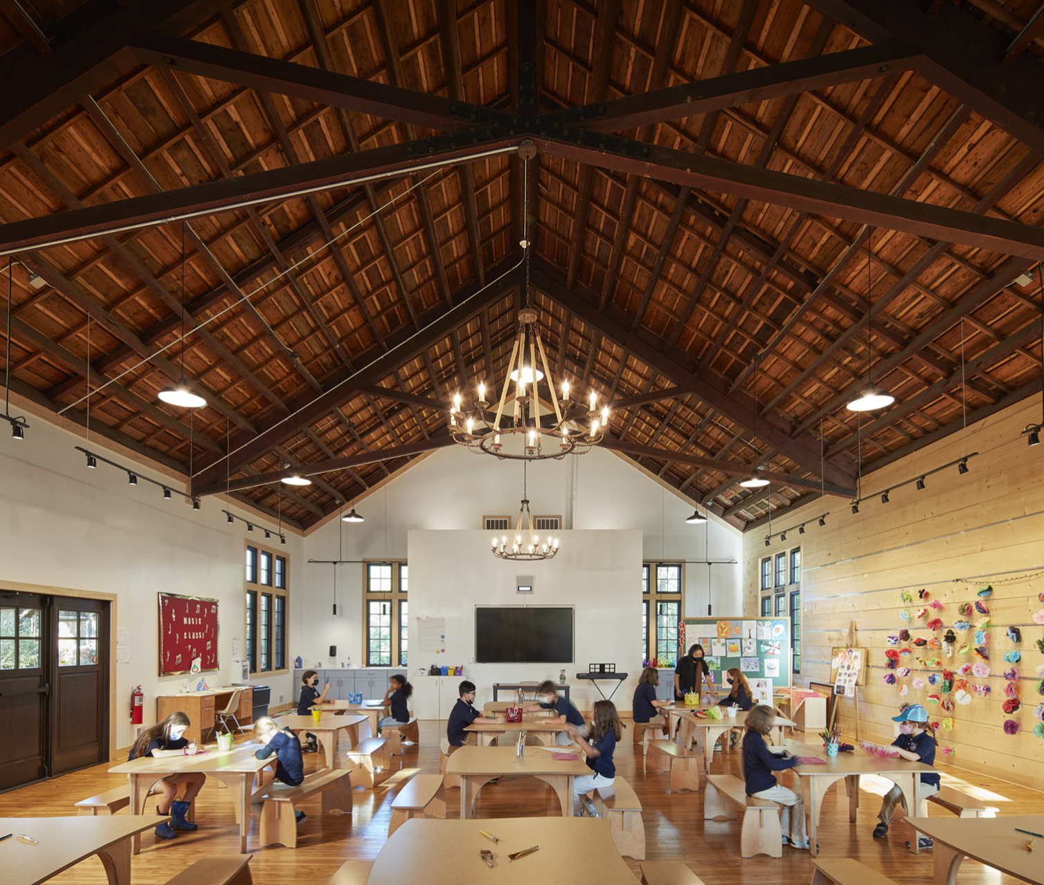
Elgin Math + Science Academy Campus
For Excellence in Interiors – Projects 5,000 SF and Above
"Sensitive and beautiful adaptive reuse with careful response to site," said one juror. "An intelligent addition to a mature campus that has grown and changed over time," said another juror. "A beautiful learning sanctuary."

Slide 23
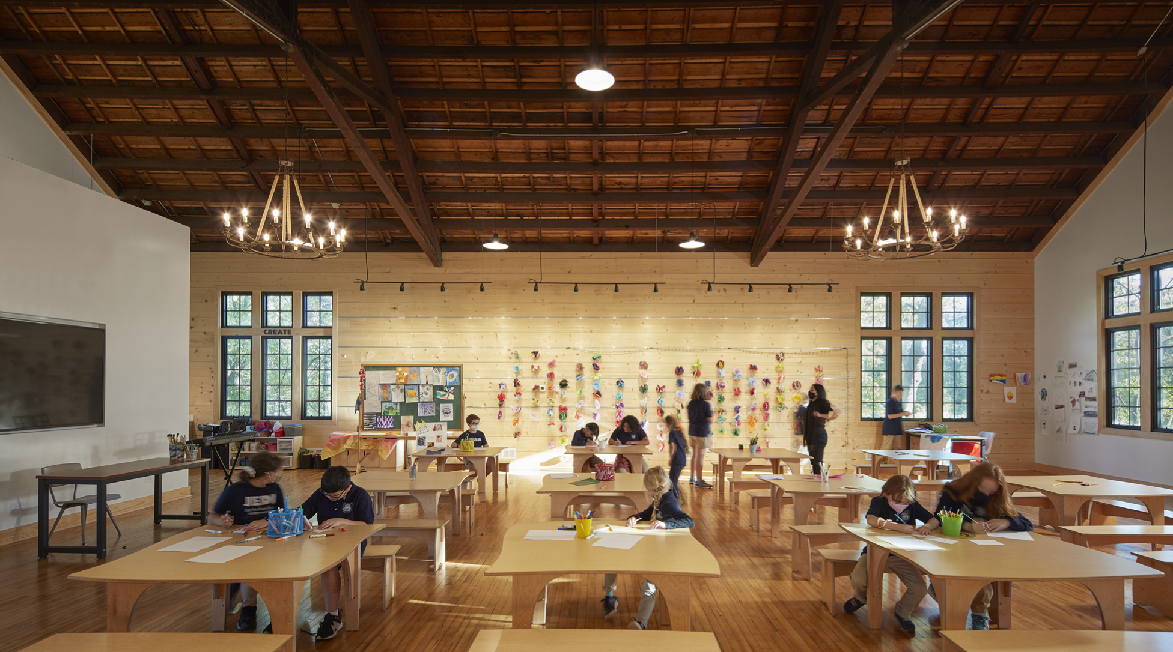

Slide 24
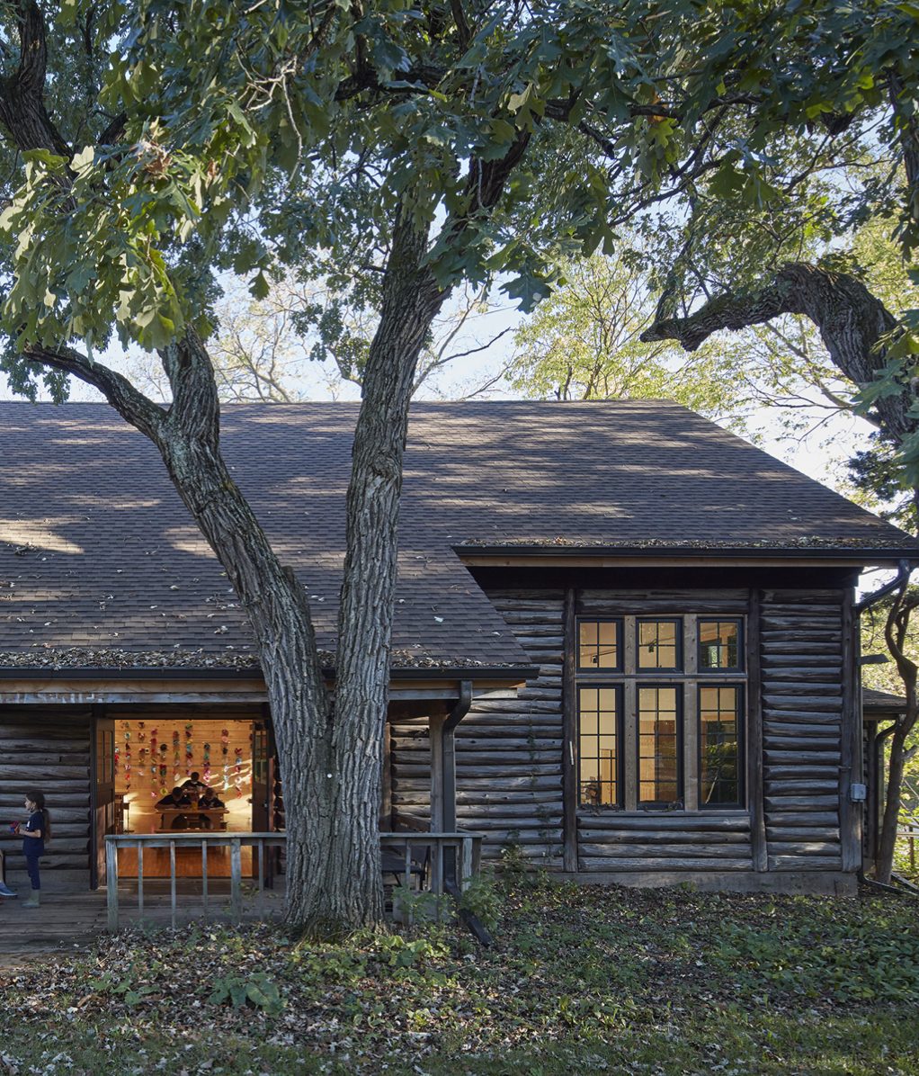
Project team includes:
Architect of Record: Wheeler Kearns Architects
-Larry Kearns, FAIA
-Fabiola Yep, AIA
-Brandon Hall
-Structural Engineer: Jim Kirk, Enspect Engineering
-Mechanical Engineer: David Brooks, McGuire Engineers
-Siamak Malek, Senior Project Manager, TERRA Engineering Ltd.
-General Contractor: Bill Truty, Bulley & Andrews

Slide 25
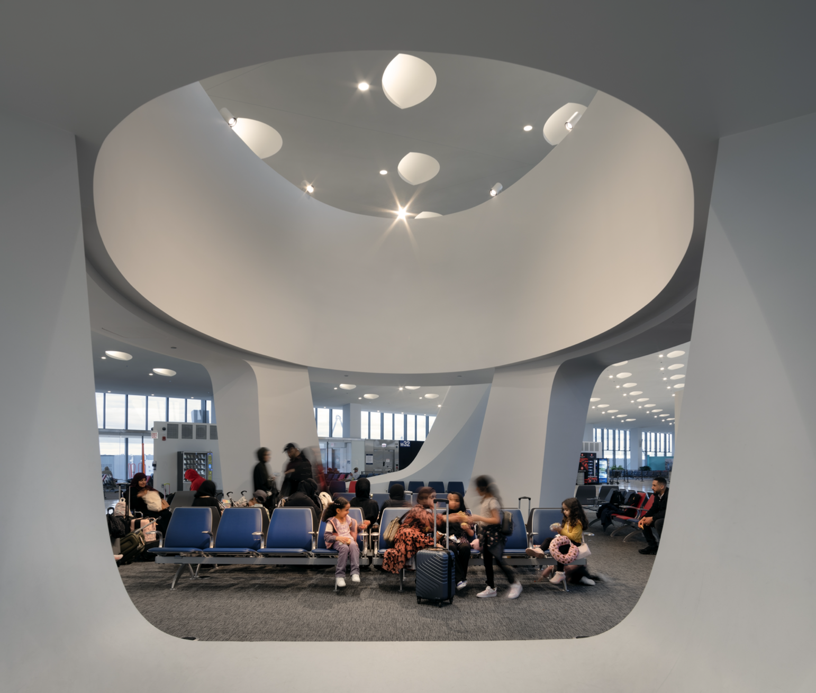
Chicago O'Hare International Airport Terminal 5 East Extension
The Capitol Award
"This is a striking addition - modest in size and scale, but not lacking in detail and thoughtful execution," said one juror. "This project is a perfect example of Design for Community though its celebration of travel, engagement of stakeholders, and champion of local arts and artists. It fully embraces the energy and excitement of travel and also provides some beautiful counterpoints of rest and contemplation for the weary traveler."

Slide 26
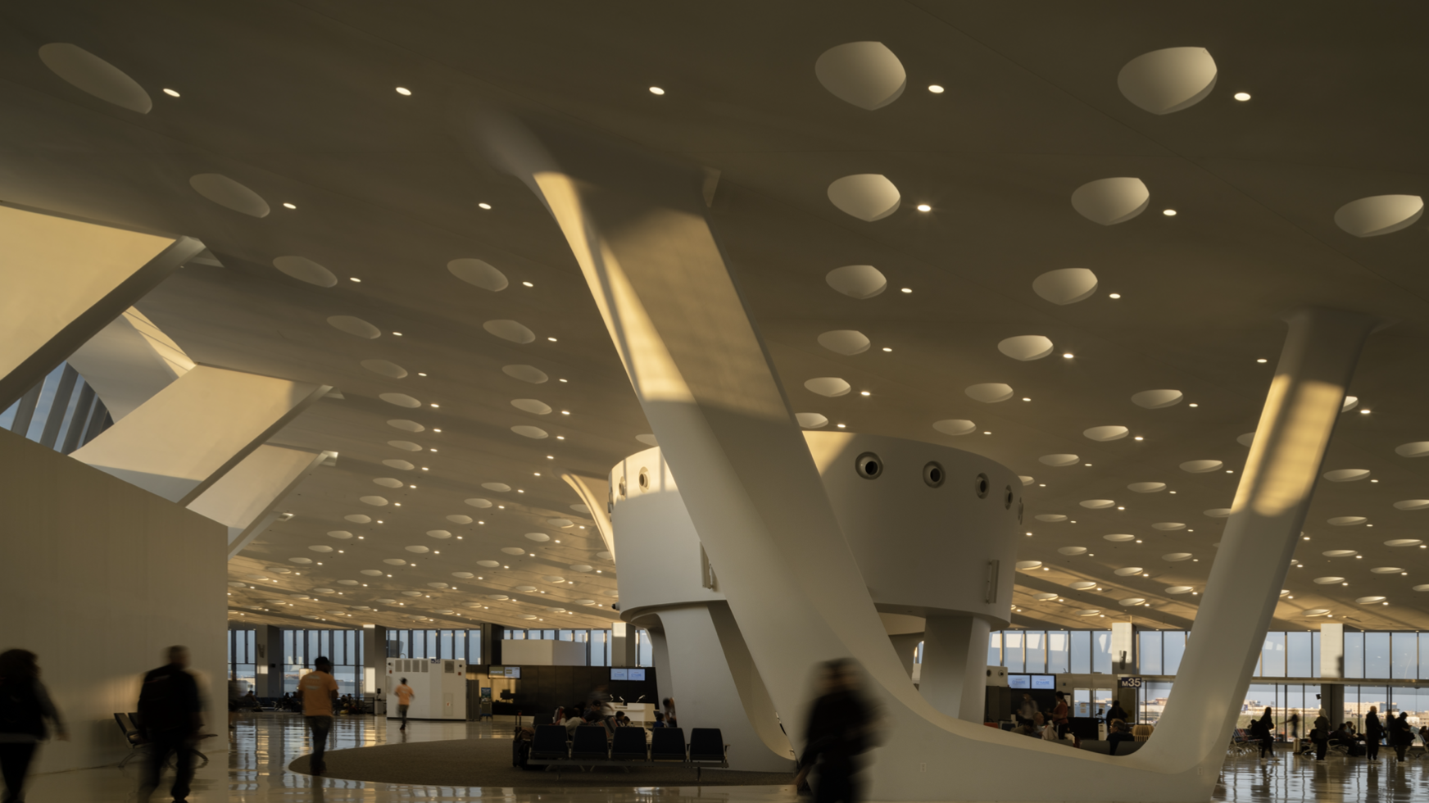

Slide 27
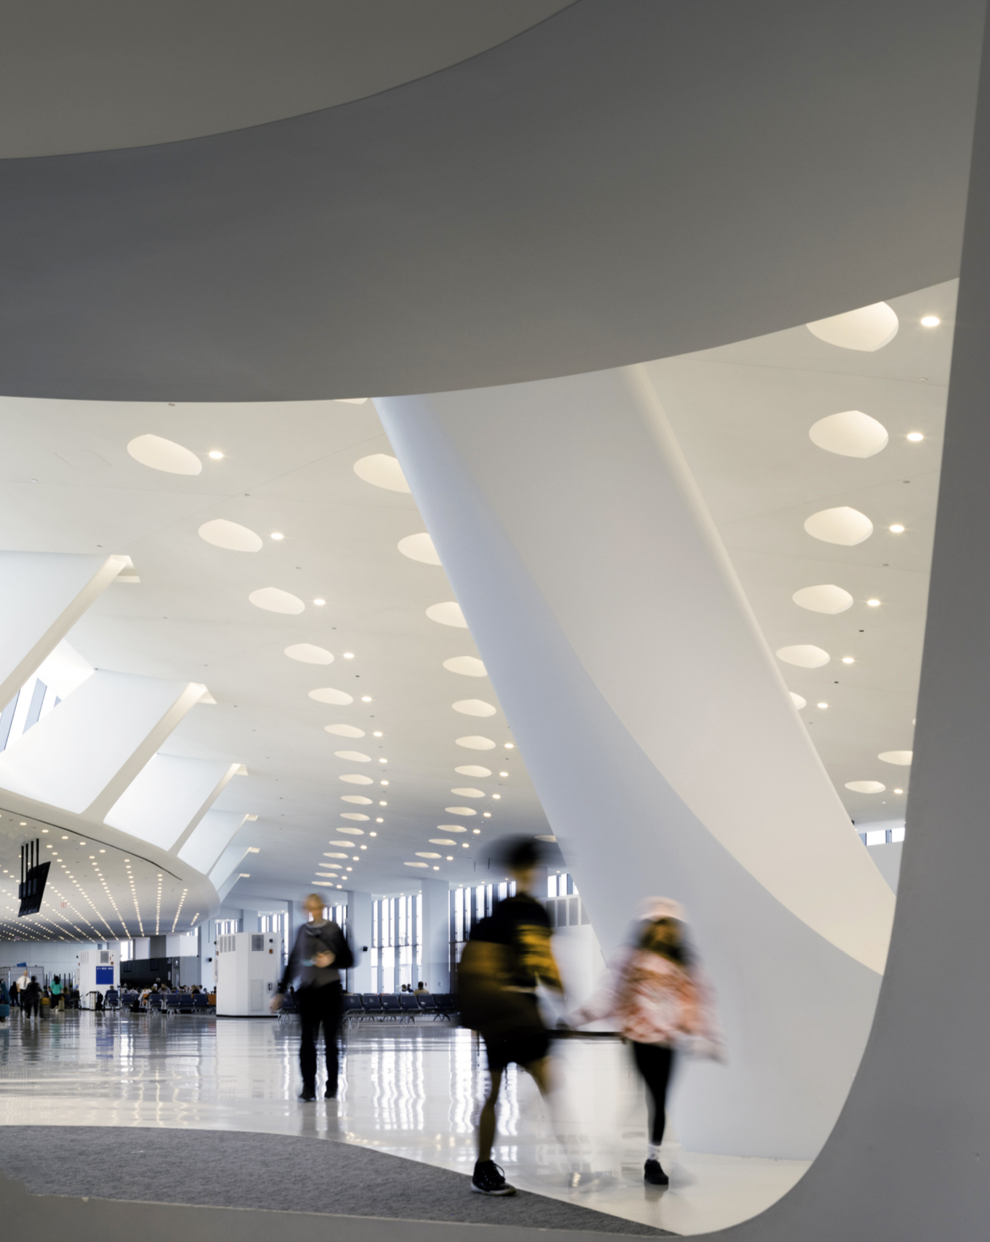
Project team includes:
Architect of Record: Muller 2
-David Steele, AIA
-Edward Frankowski, AIA
-Nicholas Micheels
-Sungano Ziswa, AIA
Architect: HOK
-William Jenkinson
-Peter Ruggiero, AIA
-Kyle Ingber
-Brent Molendyk
-Giulio Pedota
-Wendy Schuledberg
-Emily Whitbeck
-Peter Chicoine
-David McNamara
-Jeff Randerson and Andrew Pilarcik, City of Chicago
-Mechanical Engineer: George Bouris, Mill House, Inc.
-Electrical Engineer: Mark Cerbin, Fred Owens
-Structural Engineer: Brenda Karhoff, GKE, LLC

Slide 28
2023 Service Awards

Slide 29
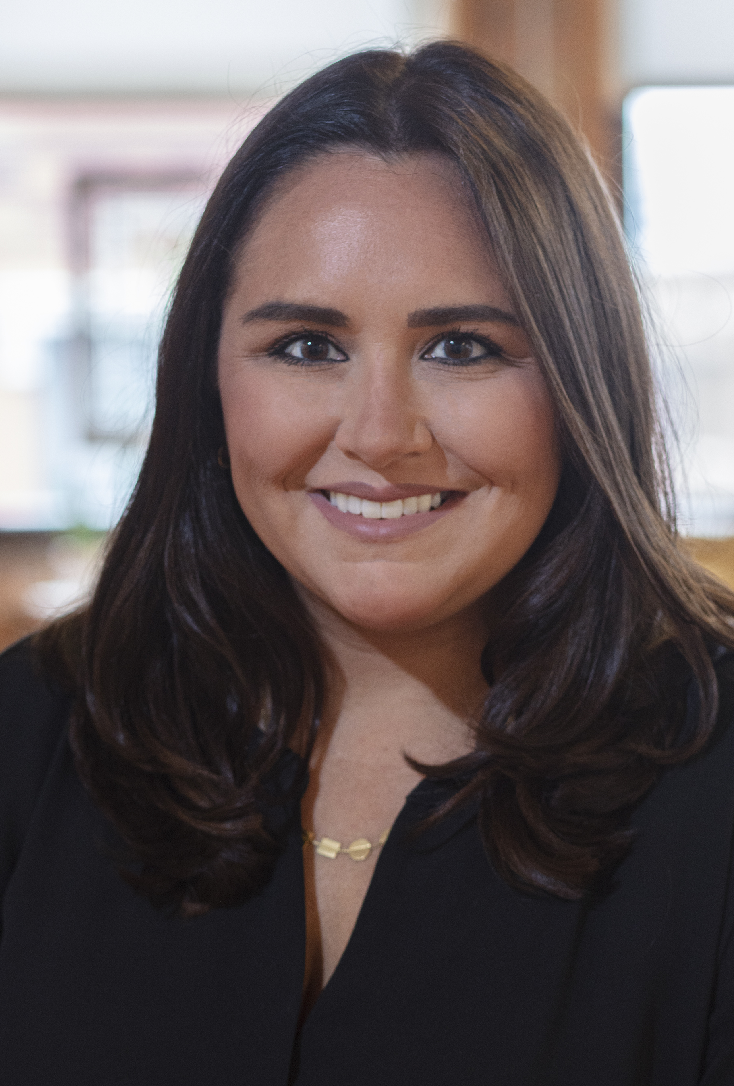
Kelly Moynihan, AIA
John Wellborn Root Award
For Emerging Professionals
Working to unify professionals for the advancement of the architecture profession as an advocate for equity and resiliency in practice and by cultivating connections in pursuit of preservation and creation of carbon-free, equitable, high- performance projects.

Slide 30
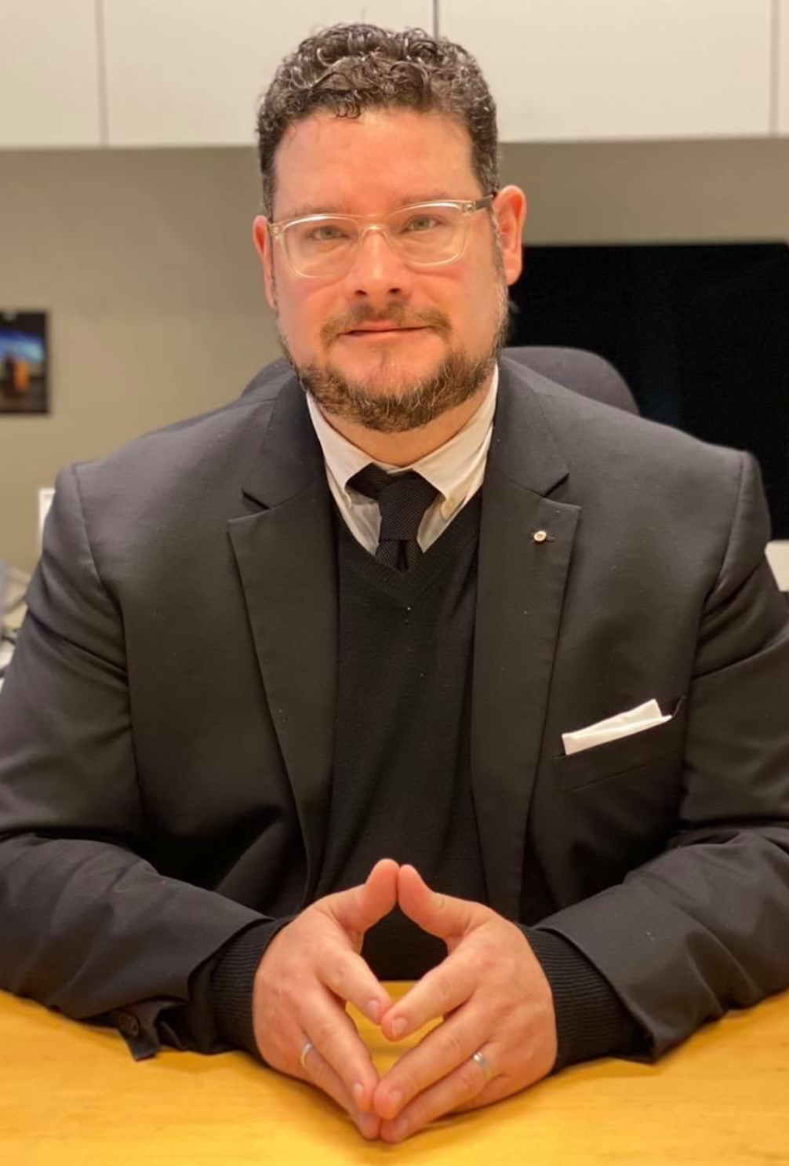
Francisco J. Rodriguez-Suárez, FAIA
Nathan Clifford Ricker Award
For Architecture Education
Committed to framing the Illinois School of Architecture as an epicenter of design, research and innovation aimed at solving contemporary society’s most pressing challenges such as global warming, housing inequities, and sustainable communities.

Slide 31
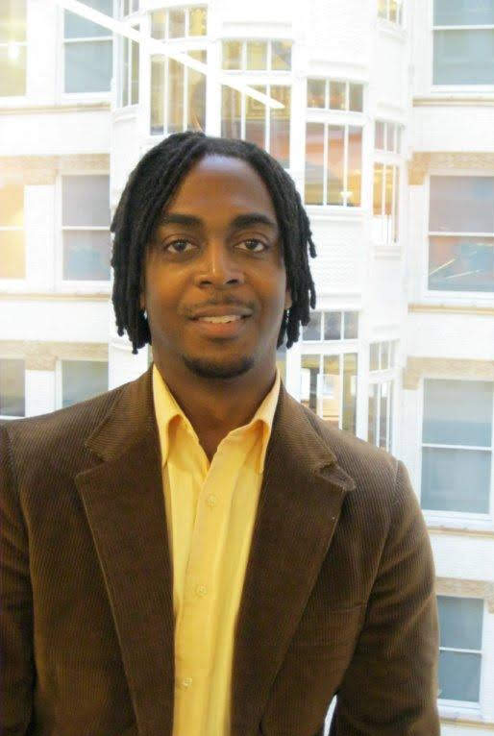
Roderic Walton, AIA
Alan Madison Award
For Diversity Work
A champion for equitable outcomes for historically disadvantaged and marginalized communities for over 25 years, his initiatives are a call to action for architects, advocating for enhanced engagement as agents for change.

Slide 32
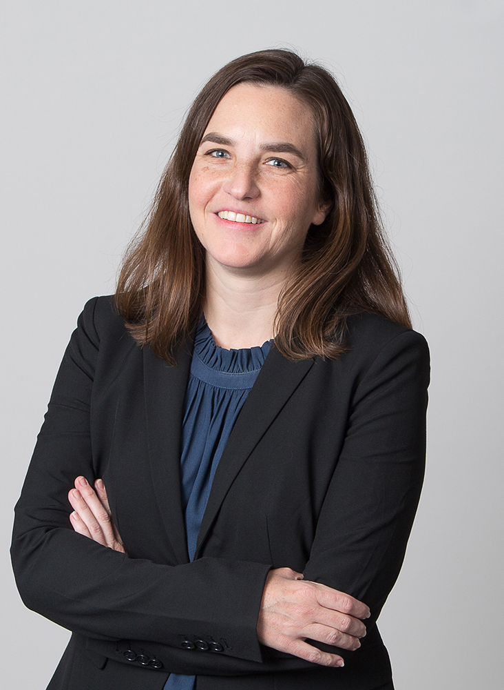
Sheri Andrews, AIA
R. Buckminster Fuller Award
For Social Good
Her unwavering commitment to maintaining rigorous design standards and her dedication to serving the Chicago community, along with empowering our internal firm community have made her a true leader.

Slide 33
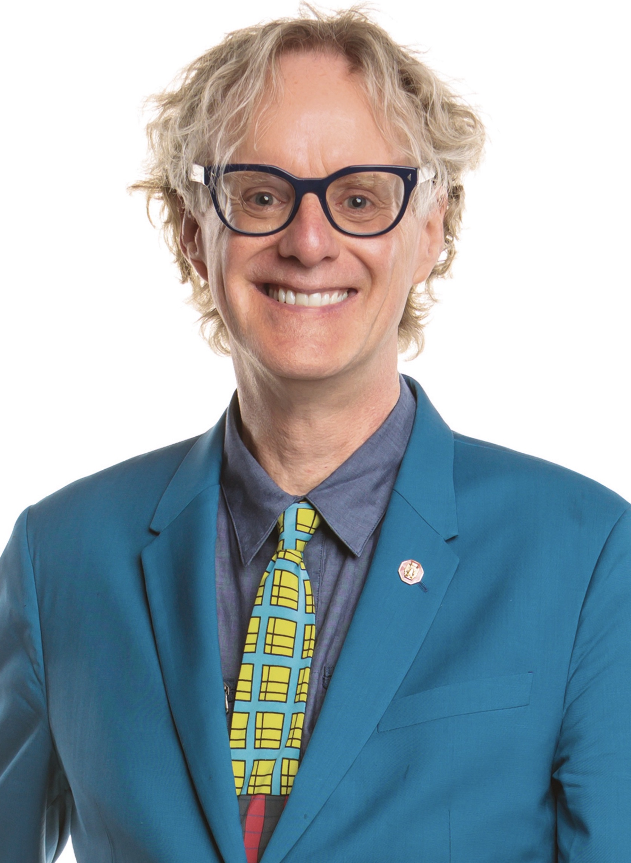
Peter Exley, FAIA
Gold Medal for Outstanding Lifetime Service
Peter Exley’s professional career has been committed to an equitable and inclusive built environment for children, families, and communities.
"Peter sets the standard for what a successful career in architecture should look like – one that is focused on joy, giving, beauty, humor, and making the world a better place in every way that you can, whenever and wherever, sometimes by simply just being present. Peter’s humanity is inspiring and I’m lucky to call him a part‐time mentor and a full‐time friend."

Slide 34
2023 Honor Awards
A Celebration of Better Illinois Communities by Design

